Slide 1



LOOK BACK 3
Part 1

Slide 2
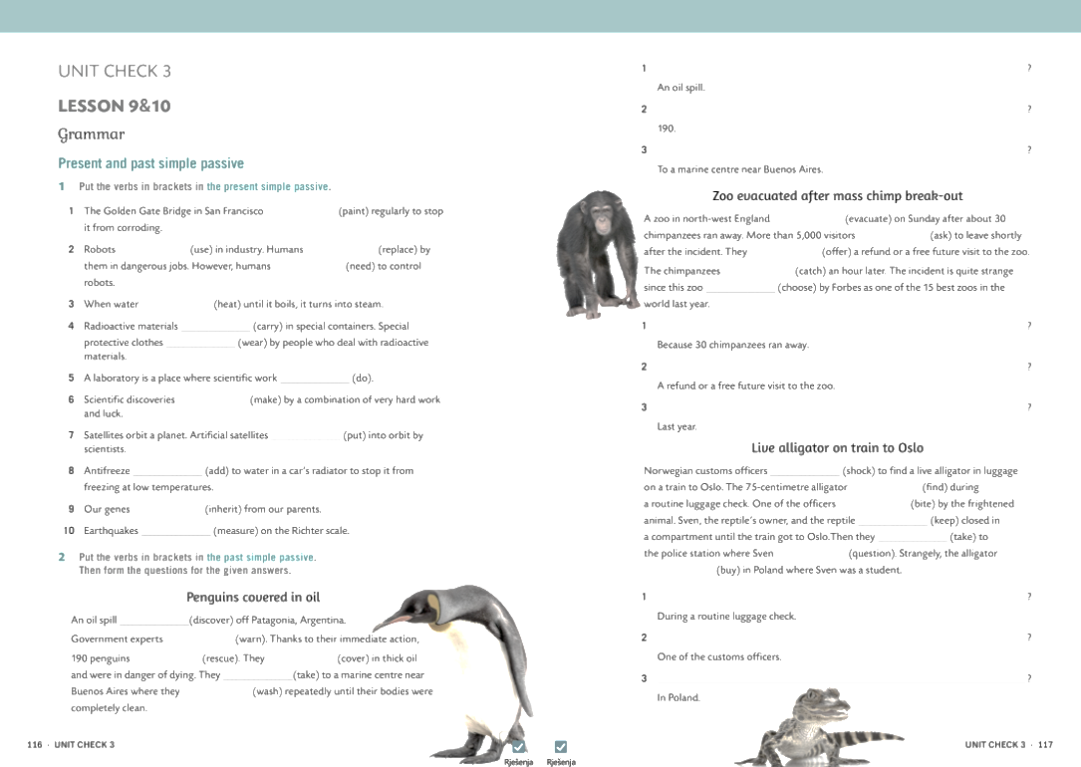
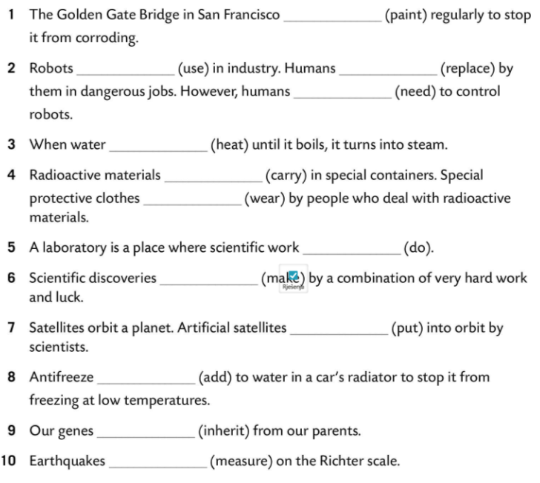
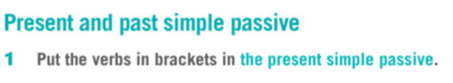
is painted
are used
are replaced
are needed
is heated
are carried
are worn
is done
are made
are put
is added
are inherited
are measured

Slide 3
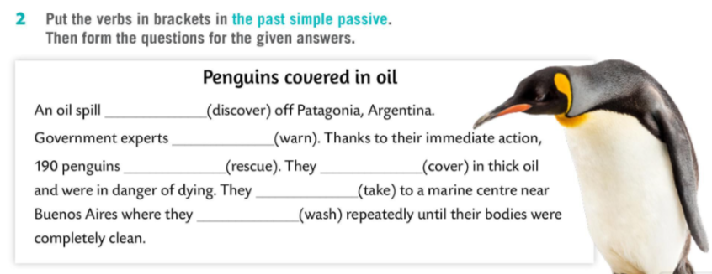
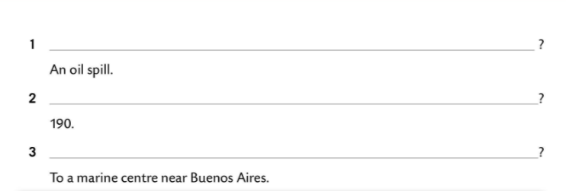
was discovered
were warned
were rescued
were covered
were taken
were washed
What was discovered off Patagonia, Argentina?
How many penguins were rescued?
Where were the penguins taken?

Slide 4
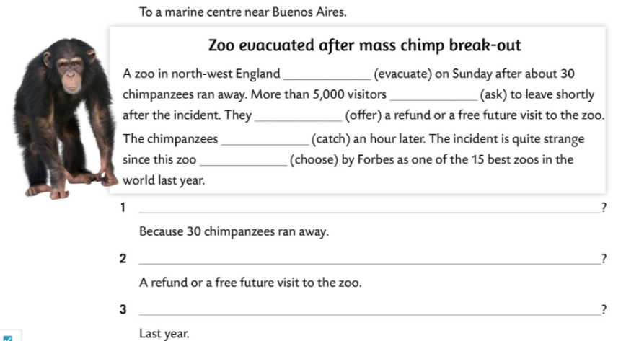
was evacuated
were asked
were offered
were caught
was chosen
Why was a zoo in north-west England evacuated?
What were the visitors offered?
When was the zoo chosen by Forbes as one of 15 best zoos in the world?

Slide 5
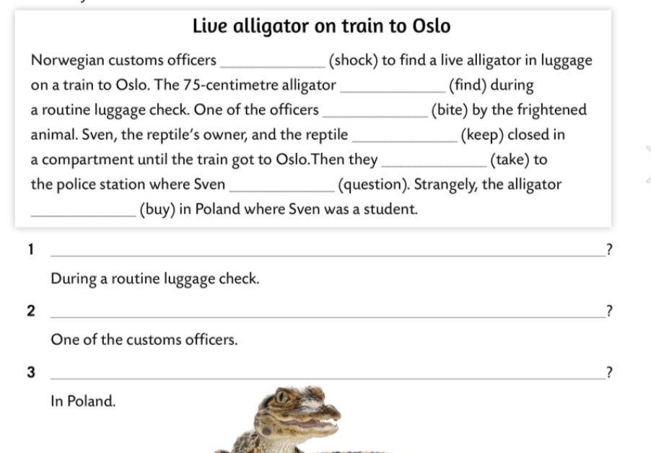
were shocked
was found
was bitten
were kept
were taken
was questioned
was bought
When was the 75-centimetre alligator found?
Who was bitten by the frightened animal?
Where was the alligator bought?

Slide 6
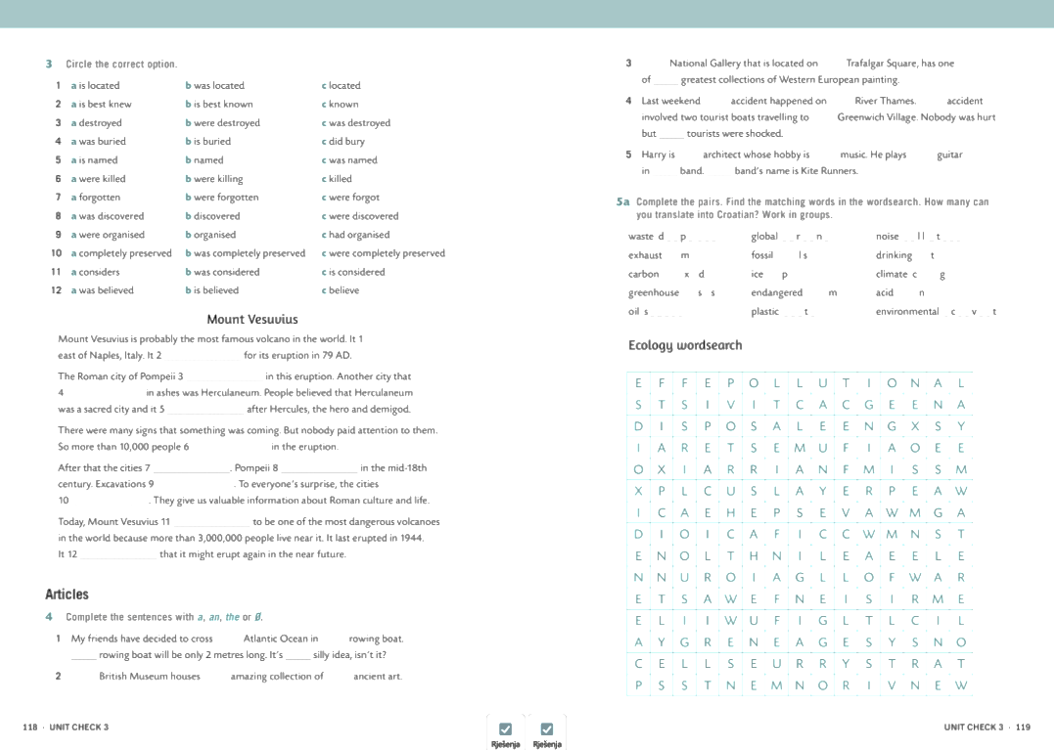
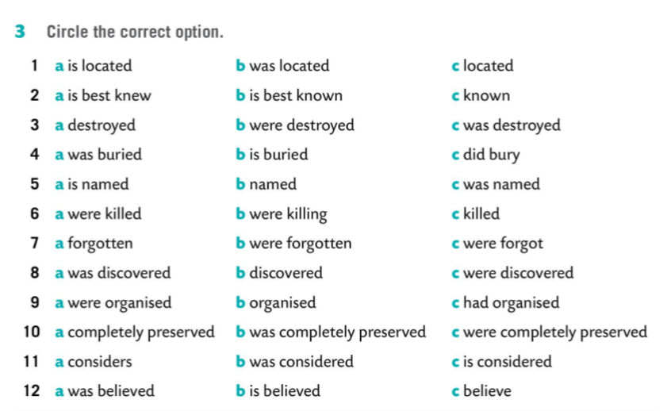
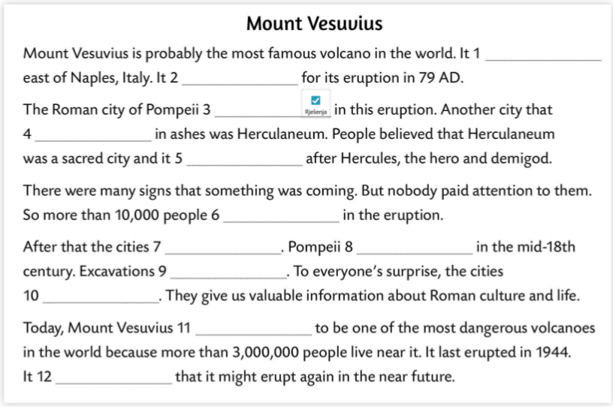
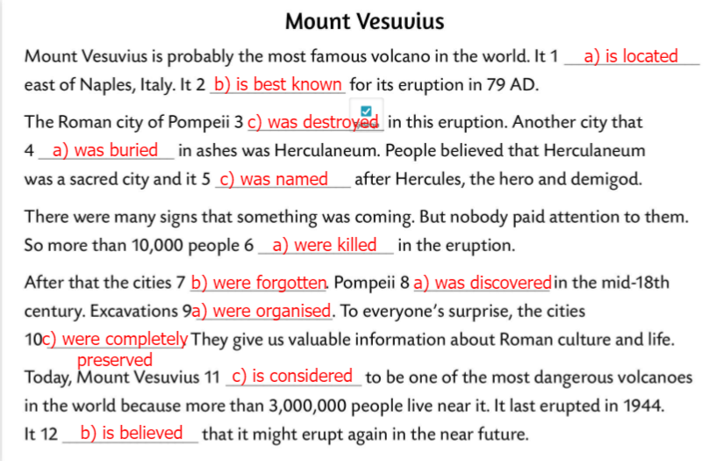

Slide 7
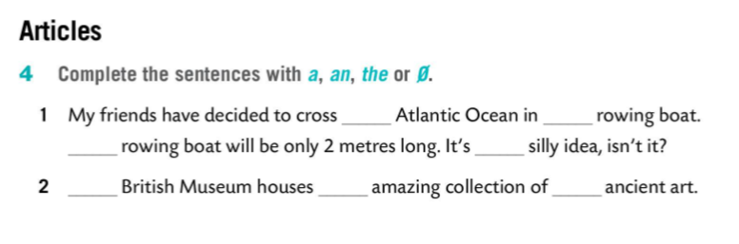
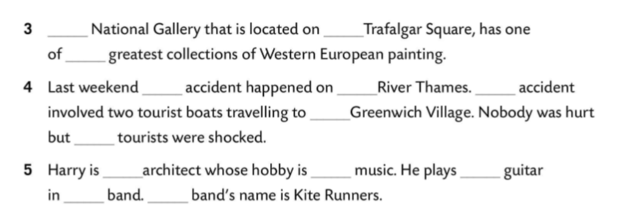
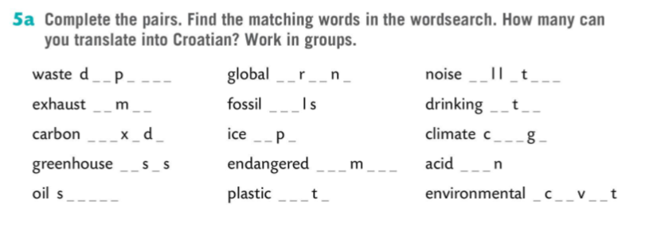
the
a
The
a
The
an
/
The
/
the
an
the
The
/
the
an
/
the
a
The
disposal
warming
pollution
fumes
fuels
water
dioxide
caps
change
gases
animals
rain
spills
waste
activist

Slide 8
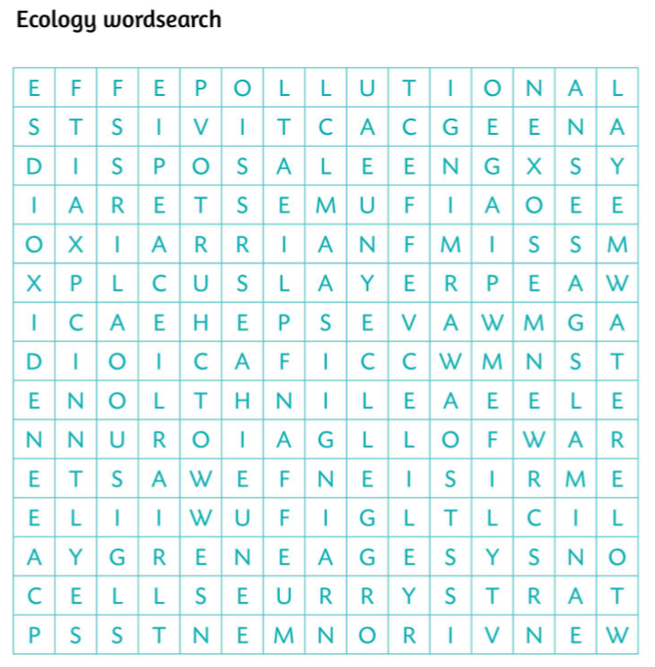


Slide 9
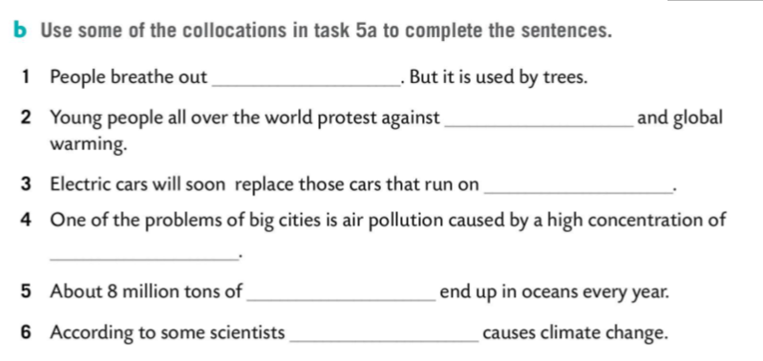


carbon dioxide
climate change
fossil fuels
exhaust fumes
plastic waste
global warming

